Slide 1
COURSE 7 INTERACTIVE DASHBOARD USING TABLEAU PROJECT ON MITIGATING BIRD STRIKES IN AVIATION
BY
KAYALVILI K G

Slide 2
PROJECT REQUIREMENTS :
TOOLS:
ANACONDA
JUPYTER NOTEBOOK
TABLEAU
DATA REQUIREMENTS:
DATASET
PYTHON LIBRARIES

Slide 3
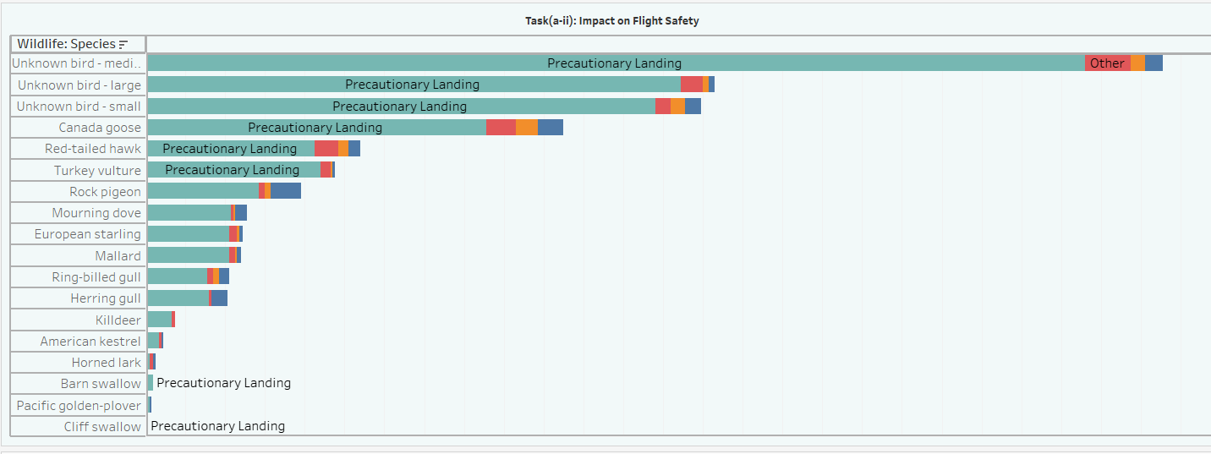
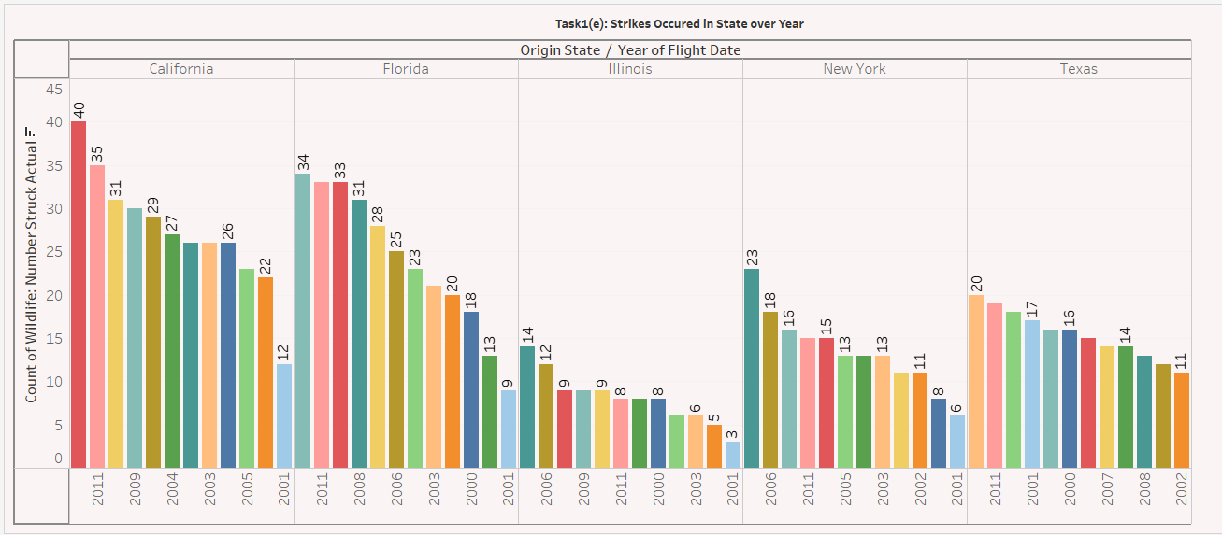
SPRINT 4
TASK 1
Interpretation TASK 1(a-ii) : The tableau visualization reveals that "Unknown bird-medium" and "Unknown bird-large" are the most frequently involved in bird strikes. "Unknown bird-medium"(472 incidents) primarily causes precautionary landings, but both "Unknown bird-medium"(precautionary landing - 472 incidents, other- 23 incidents , Engine shut down- 7 incidents , aborted takeoff- 9 incidents) and "Unknown bird-large" (precautionary landing - 269 incidents, other- 11 incidents , Engine shut down- 3 incidents , aborted takeoff- 3 incidents) strikes result in a diverse range of impacts, including aborted take-offs, engine shutdowns, and precautionary landings. This suggests that Unknown bird-large and medium pose a more significant threat to flight safety compared to other species.
Interpretation Task 1(e): The tableau visualization reveals that the number of wildlife strikes in California, Florida, Illinois, New York, and Texas(TOP 5) has fluctuated over the years. California experienced a significant increase in strikes in 2010 with 40 incidents, and declined in 2001 with 12 incidents. Florida shows highest strikes in the year of 2009 with 34 incidents and New York show similar patterns, with peaks in 2008(23 incidents) and 2006(18 incidents). Illinios and Texas had relatively lower strike rates throughout the period, with occasional spikes

Slide 4
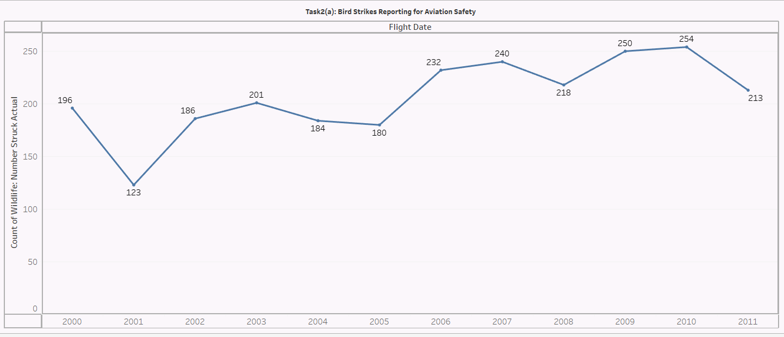
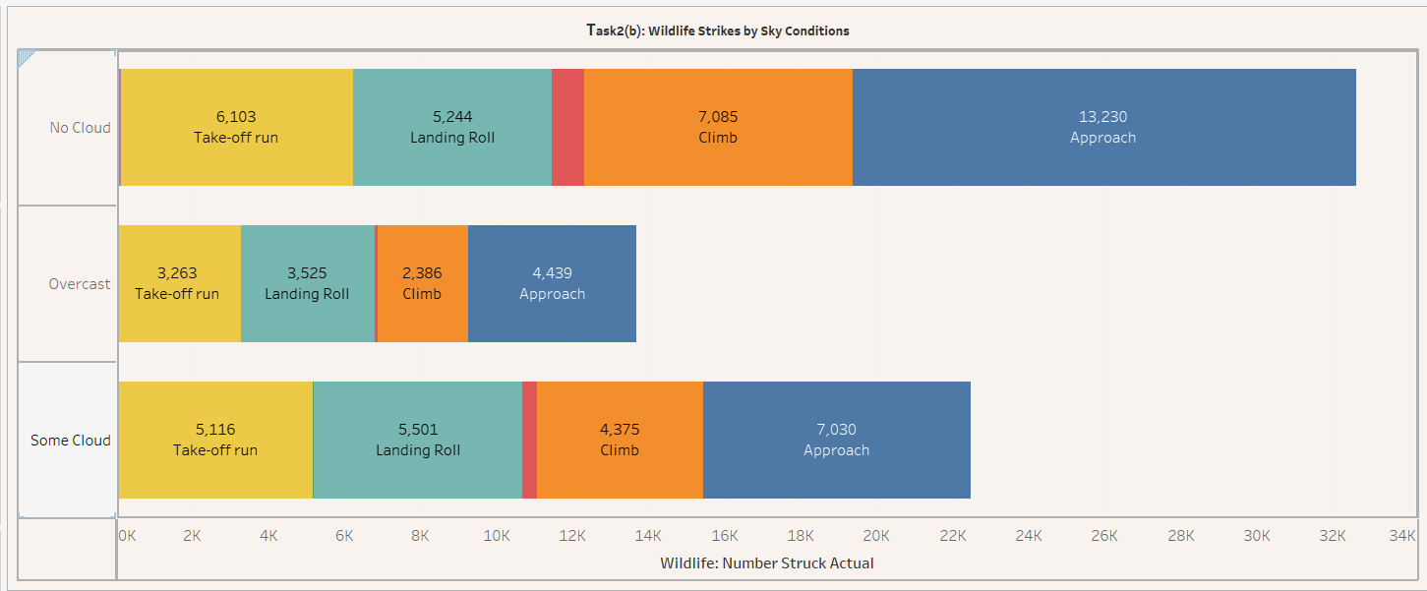
TASK 2
Interpretation Task 2(a): The tableau visualization reveals a fluctuating trend in the number of reported wildlife strikes from 2000 to 2011. While the data suggests an increase in reporting from 2000 to 2006, followed by a decline in 2011, it suggests a potential increase in the number of reported bird strike incidents over the period 2009 and 2010.
Interpretation Task2(b): The tableau visualization reveals that most wildlife strikes occurred under "No Cloud" conditions (in Approach Phase with incidents of 13,230) , followed by "Some Cloud"( in Approach Phase with incidents of 7,030) and "Overcast"(with 4.439 incidents in approach phase). This suggests that clear or partially cloudy skies are more conducive to wildlife encounters, potentially due to increased visibility or favorable weather conditions for wildlife activity.

Slide 5
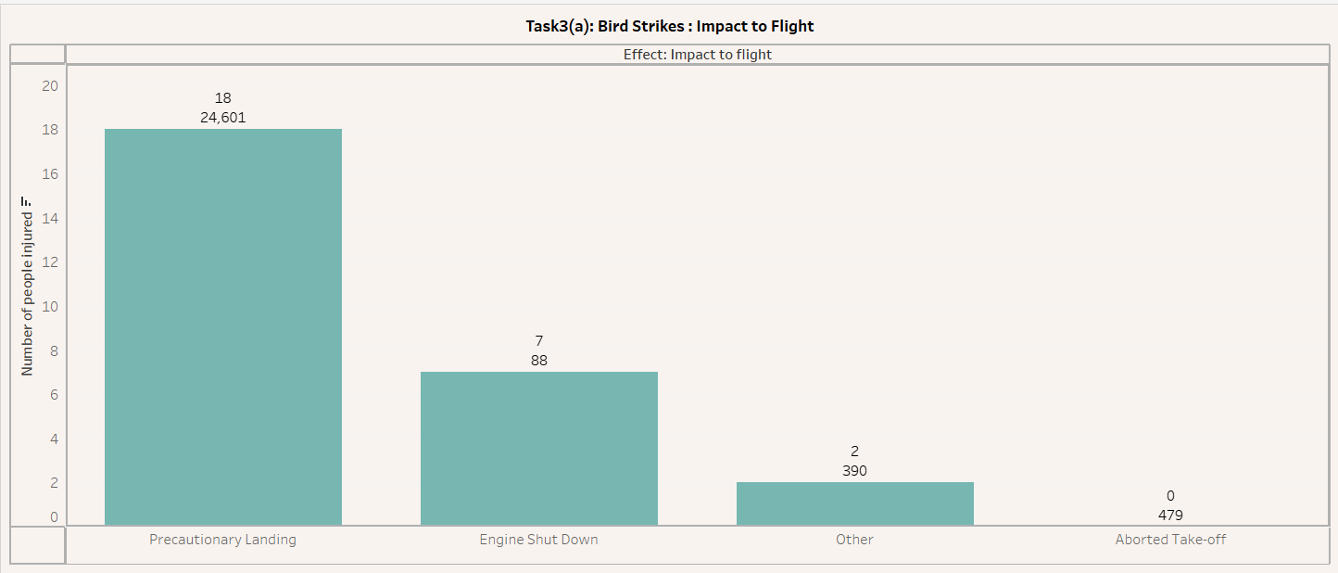
Task 3
INTERPRETATION Task 3(a) : This visualization reveals that precautionary landings are the most common incidents resulting in injuries, with 24,601 cases reported. Engine shutdowns and other incidents account for fewer injuries. To prevent injuries, measures such as improving bird strike detection systems, enhancing airport infrastructure to deter wildlife should be considered.

Slide 6
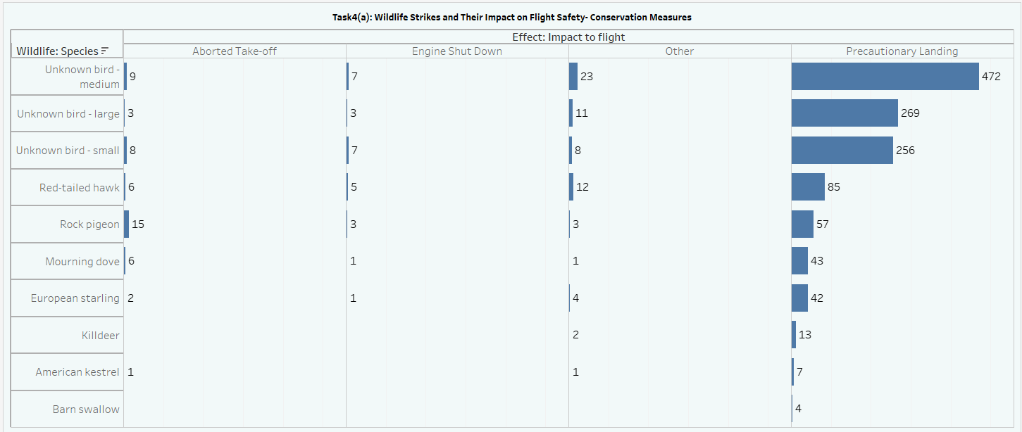
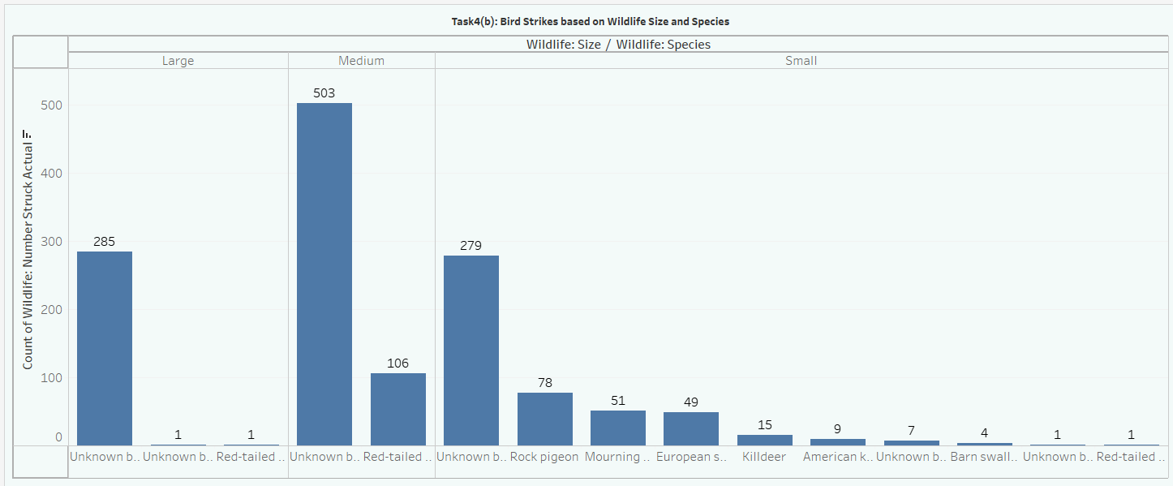
TASK 4
Interpretation Task 4(a) : The tableau visualization reveals that "Unknown bird-small" and "Unknown bird-medium" are the most frequently involved in bird strikes which leads to precautionary landings (Unknown bird-medium – 472 incidents, Unknown bird-large – 269 incidents and Unknown bird-small – 256 incidents). To reduce their presence near airports, conservation measures such as habitat modification, bird deterrent techniques, and increased airport surveillance can be implemented.
Interpretation Task 4(b) : The tableau visualization reveals that "Unknown bird-medium"(503 incidents) is the most frequently involved in bird strikes, followed by "Unknown bird-small"(279 incidents) and "Large" (285 incidents) birds. This suggests that medium-sized birds pose the greatest risk to aircraft safety. Among known species, Unknown birds - Medium , Small and Large are more frequently involved than others.

Slide 7
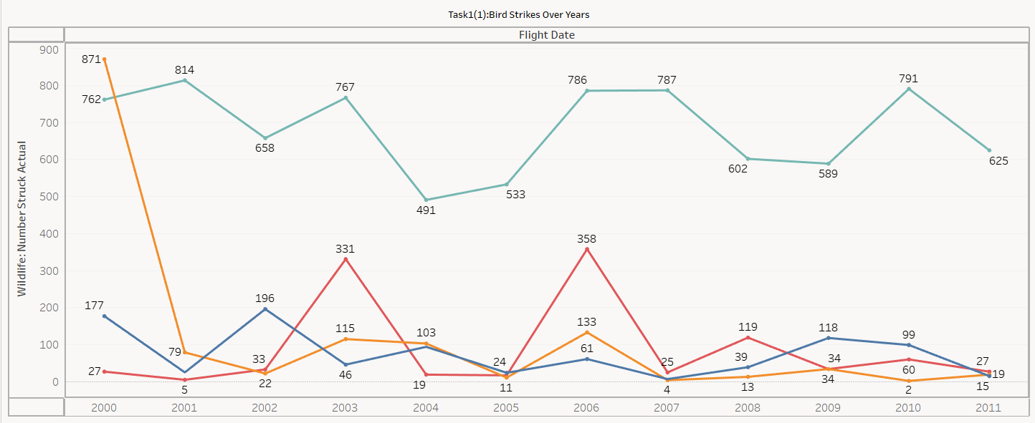
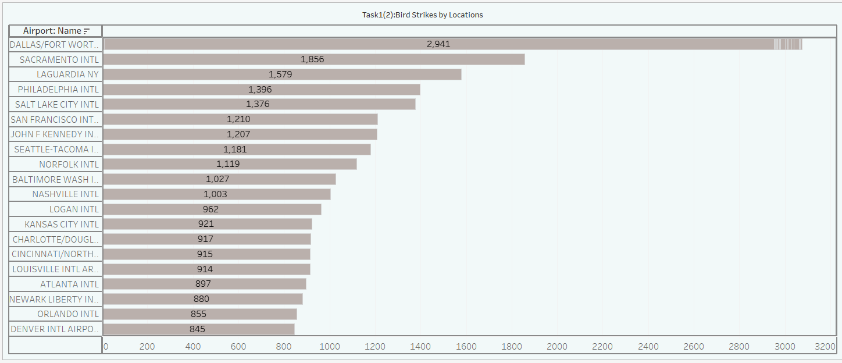
SPRINT 5
TASK 1
INTERPRETATION Task1(a) : The chart illustrates the number of wildlife strikes on flights from 2000 to 2011, with most strikes in 2000 (871 incidents during engine shut down) and a decrease by 2011 (625 incidents during precautionary landing). Additionally, 2006 saw a notable peak in precautionary landings due to wildlife strikes (358 incidents during other impact to flight).
INTERPRETATION Task 1(b) : The bar chart shows that Dallas/Fort Worth Airport experienced the highest number of wildlife strikes (2,941), followed by Sacramento International Airport (1,856) and Laguardia Airport (1,579). The airports listed have wildlife strikes ranging from 845 to 2,941, highlighting significant variability across locations.

Slide 8
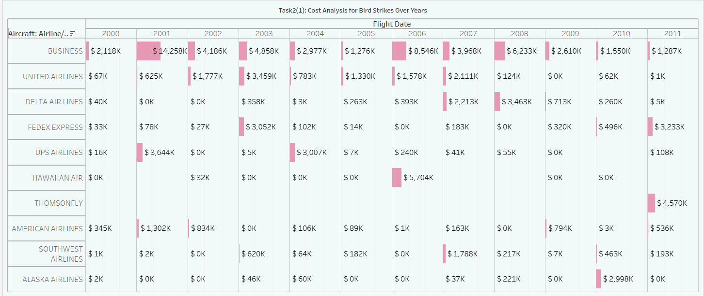
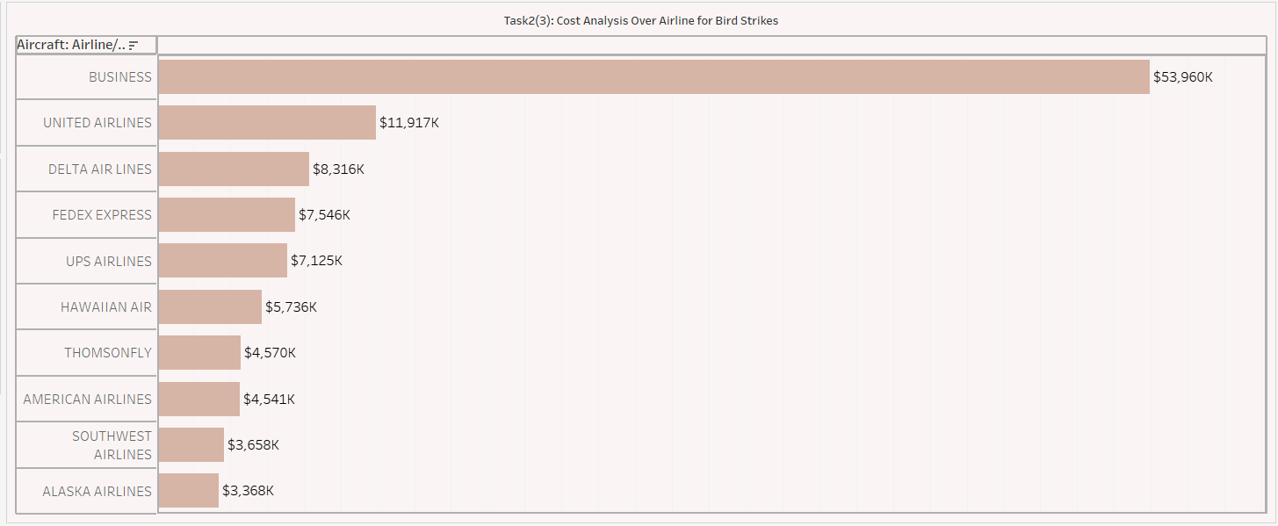
TASK 2
INTERPRETATION Task 2(1): The tableau visualization reveals a significant increase in overall flight costs from 2000 to 2009, peaking at $14.258K in 2001. Subsequently, costs declined until 2011, with a notable surge in 2010. Business experienced the most substantial cost growth, followed by United Airlines comparatively.
INTERPRETATION Task 2(3) :
Business Airline faced the highest financial impact from wildlife strikes, with a total cost of $53.96K. United Airlines experienced a significant cost of $11.927K, followed by Delta Airlines, which incurred $8.32K in total costs. These figures highlight the varying economic burdens faced by different airlines, suggesting a need for airline-specific mitigation strategies to address wildlife strike-related expenses.

Slide 9
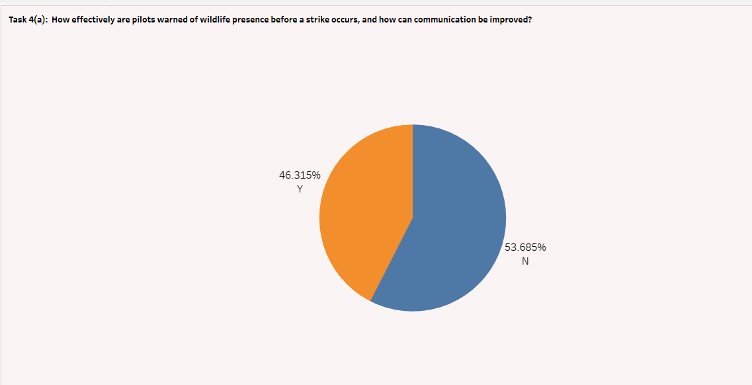
TASK 4
INTERPRETATION Task4(a) : This pie chart shows the gaps in communication protocols, showing more thorough warning systems are needed for pilots. Since more strikes occur without a warning (58.25%), improved communication and alert systems should be implemented.

Slide 10
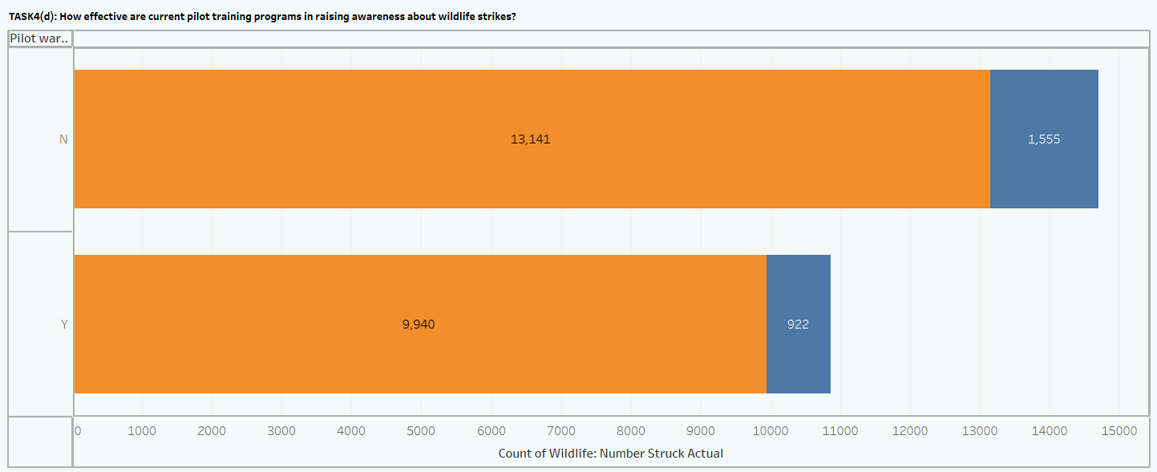
INTERPRETATION Task 4(d) : This chart will help show whether pilots who received warnings about wildlife strikes had lower incidents and less damage compared to those who did not receive warnings. Even though there was less damage comparatively, but still there 922 count caused damage in which the pilot was informed, this shows that the pilots may still require training to act as soon as informed of the strike. The effectiveness of pilot training programs can be inferred by the extent to which pilots respond to these warnings.

Slide 11
BUSINESS INSIGHTS

Slide 12
INSIGHTS FOR SPRINT 4 & 5
Most Common Bird Species Involved in Strikes:
Unknown bird-medium (472 incidents leading to precautionary landings) and Unknown bird-large (269 incidents leading to precautionary landings) are identified as the most frequent threats, suggesting these species pose a significant safety risk. They result in various impacts such as engine shutdowns and aborted take-offs, necessitating immediate flight responses.
Wildlife strikes tend to occur most frequently in conditions of "No Cloud" visibility (13,230 incidents during approach), followed by "Some Cloud" (7,030 incidents during approach). This could indicate better visibility for birds, making them more prone to fly in such weather.
Geographic Trends:
California, Florida, New York, Illinois, and Texas are identified as the top states with wildlife strikes, showing fluctuating trends over the years. For example, California saw a peak in 2010 (40 incidents), while Florida and New York experienced high peaks in 2009 and 2008, respectively.
Dallas/Fort Worth Airport reported the highest number of wildlife strikes (2,941), suggesting that larger airports with higher traffic volumes are more vulnerable to such incidents.

Slide 13
Phases of Flight with Highest Risk: Strikes during the approach phase are most prevalent, particularly under clear skies. This highlights the need for focused bird detection systems and wildlife deterrence efforts during the approach to airports.
Impacts of Strikes: Precautionary landings are the most common safety measure following wildlife strikes, with 24,601 cases reported. Engine shutdowns and aborted take-offs also occur but less frequently. There were 922 incidents where pilots were warned but still encountered damage, underscoring the need for improved training and faster response protocols.
Financial Burden on Airlines: Wildlife strikes have a significant financial impact, particularly on Business Airlines, which faced the highest costs at $53.96K, followed by United Airlines ($11.927K) and Delta Airlines ($8.32K).
The cost of wildlife strikes peaked at $14.258K in 2001, highlighting the financial strain these incidents can impose, particularly during peak strike years. There was a noted increase in costs in 2010 after a declining trend in the late 2000s.
Mitigation Strategies for Financial Losses: The analysis points to a need for airline-specific wildlife mitigation strategies, as different airlines face varying levels of financial burden. Business Airlines, for example, should prioritize investments in wildlife detection systems and flight crew training programs.

Slide 14
Communication and Prevention Strategies
Gaps in Warning Systems: Over 58.25% of wildlife strikes occurred without warning, indicating a significant gap in communication protocols. Pilots and ground staff need more robust early warning systems to minimize damage and incidents.
Pilots who did receive warnings often still experienced damage, pointing to the need for enhanced pilot training and reaction protocols when notified of potential wildlife encounters.
Safety Enhancements: Recommendations for improving safety include the deployment of advanced wildlife detection systems, airport habitat modification to deter wildlife, and pilot training programs to ensure faster responses upon receiving warnings.

Slide 15
summary
The data from wildlife strike reports indicate a need for concerted efforts to reduce the frequency and impact of bird strikes on flights.
Airports in high-incident states, such as California and Texas, should prioritize wildlife management strategies.
Furthermore, airlines, particularly Business Airlines and United Airlines, should address the financial and operational risks through tailored mitigation efforts.
Improving communication protocols and pilot training will also be critical, as timely warnings and pilot responses can significantly reduce the damage and cost implications of wildlife strikes.
Finally, deploying more sophisticated detection and deterrence systems will help airports manage wildlife risks more effectively.

Slide 16
THANK YOU

